Slide 1
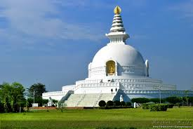
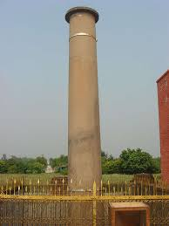
Lumbini
Lord Buddha was born at Lumbini
Location
Lumbini is situated in Nepal about 22 kms from. 122 kms from Gorakhpur city in Uttar Pradesh . 181 Kms from Kushinagar of Uttar Pradesh and
Attractions
The Ashokan pillar - The Ashokan Pillar, essentially erected by Ashoka (249 BC) visited Lumbini and erected an inscribed Ashokan Pillar on the spot of Buddha's birth. The inscription of the pillar (the oldest in Nepal) declares that Ashoka granted Lumbini tax-free status in honor of Buddha’s birth
Kapilvastu - A holy destination related deeply with the life of a legend, Lord Buddha, eventually Kapilvastu is the place where Lord Buddha had lived the childhood and the days of teenage, in complete luxury

Slide 2
Bodhgaya
A place where Lord Buddha, It was here under a banyan tree, the Bodhi Tree, Gautama attained supreme knowledge to become Buddha, the Enlightened One
There is a magnificent Mahabodhi temple and the Tree from the original sapling still stands in the temple premises. The temple is an architectural amalgamation of many centuries, cultures and heritages
It is perhaps still the same temple Hieuen Tsang visited in 7th century
It is perhaps still the same temple Hieuen Tsang visited in 7th century
Attractions
Mahabodhi Tree - The tree is considered holy since Lord Buddha attained enlightenment under it , it is probably the fifth succession of the original tree.
Vajrasana - The stone platform, where Lord Buddha sat in meditation while he attained enlightenment is known as Vajrasana.

Slide 3
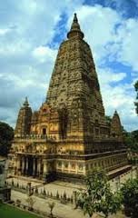
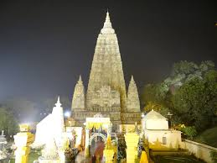
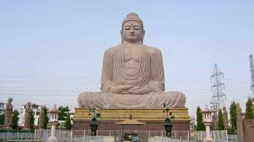
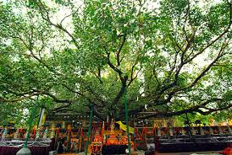
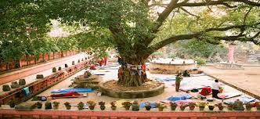
Bodhgaya

Slide 4
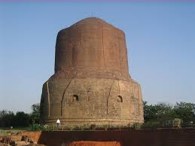
Saranath
Just 10 Kilometers away from sacred Hindu city; Varanasi, the sacred most city for Buddhist world lies
Emperor Ashok constructed three memorial stupa, the place where Buddha used to stay in Sarnath
In 1835, the place was well identified by British Archeologist Alexander Cunningham
In 1905 one museum was constructed here to in-house the objects founded here. The four lion capital ( now National Emblem of India ), Statue of Bodhisatva with huge carved umbrella ( 1st Cent. A.D.), Image of Buddha in preaching posture ( 5th Cent. A.D.) and unfinished statue of Shiva, killing Andhakasure ( 12th Cent. A.D.) are some of the very remarkable objects, shown here.
Location
State : Uttar Pradesh
Location : 10 Kilometers from the holy city of Varanasi.
Significance : Lord Buddha preached his first sermon.

Slide 5
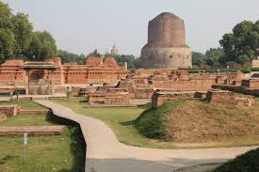
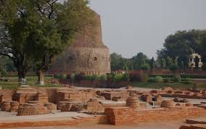
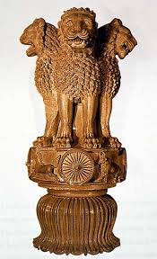
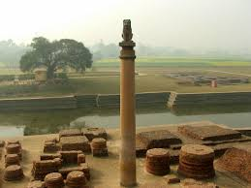
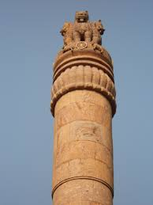

Slide 6
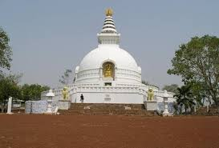
Rajgir
Rajgir, it was the first capital of Maurayan Empire
Rajgir is located in the Nalanda district of Bihar, India.
Gautama Buddha spent twelve years in Rajgir, one of his favorite places to meditate
It was here that Bimbisara, the Emperor of Magadha, and one of the most celebrated patrons of Buddhism, was converted to the faith by the Buddha. It was also here that the Buddha delivered many sermons, and that the first attempt at documenting his teachings was made.
The Saptaparni caves found here hosted the first Buddhist council after the Buddha
Location
State : Bihar
Location : Southern Bihar.74 kilometers from Bodhgaya and 100 kilometers from Patna.

Slide 7
Sravasti
This is where the Buddha spent the maximum amount of his time in the duration after attaining Nirvana. He spent 25 years here.
It was also here that the Buddha supposedly performed miracles for fifteen days upon being challenged by the leading authorities on the six major schools of philosophy dominant in the country at the time
Location
State : Uttar Pradesh
Location : In Gonda district in the eastern Uttar Pradesh

Slide 8
Sankasya
According to Buddhist legend, after the Buddha performed his greatest miracles at Sravasti, he went on to preach the Sankasya and he descended from this heaven accompanied by the gods and Brahma
It is widely believed that the temple found at the site today is the precise spot where the Buddha’s right foot touched mortal ground after coming back from the heavens
Location
State of Uttar Pradesh
District Farrukhabad district

Slide 9
Nalanda
Built on a hallowed site where the Buddha had often stayed, Nalanda is one of the world's oldest living cities.
The Buddhist University of Nalanda, once the most prestigious center of learning in Asia, was built here.
Nalanda is located in the eastern Indian state of Bihar. It is well known as the ancient centre of learning which has the remains of the great Nalanda University and several monasteries and temples.
Location
State : Bihar
Location : Nalanda is located 14 kms. from Rajgir.

Slide 10
Kushinagar
The most noteworthy thing about the history of Kushinagar is that the Buddha chose it as the place for his last sermon and the attainment of parinirvana (attainment of nirvana in death, the ultimate nirvana). It is widely believed that the Buddha chose this site for his last sermon and death
Location
State : Utter Pradesh
Location : 53 km from Gorakhpur.

